Slide 1

离散数学
Discrete Mathematics
钟芳明
离散数学
Discrete Mathematics

Slide 2
Review
Definition of set
Representation of set
Set extension and connotation
Cardinality
Relationship between sets
Equality
Subset, proper subset
Universal set
Power set
Coding presentation of power sets
Binary representation of subsets

Slide 3
Chapter 3 Set Theory
3.2 Set Operations

Slide 4
Set Operations
集合运算
交 并
差（补）
对称差分
基本定律
包含排斥原理
Intersection
Definition: set of all common elements of sets A and B, is called intersection of A and B, written as A∩B.
Union
Definition: set of all elements of sets A and B, is called union of A and B, written as A∪B.

Slide 5
Difference (set complement)
集合运算
交 并
差（补）
对称差分
基本定律
包含排斥原理
Definition: For sets A and B, the set of all the elements that belong to A but not to B, is the difference set of A and B, also called the relative complement of B with respect to A, written as A - B.
Absolute complement: The relative complement of A in E is called absolute complement, complement for short, written as ~A.
A
A
~A
B
A - B

Slide 6
3.Difference (set complement)
集合运算
交 并
差（补）
对称差分
基本定律
包含排斥原理
Example: Assume A is a set of prime numbers less than 10, set B is a set of odd numbers, find the set A-B.
Solution: A={1,2,3,5,7} B={1,3,5,7,9}
A-B={2}
Example : Assume U=Z (Z is the set of integers)
A = {i | i ∈ Z, i > 0}
Solution : U – A = {i | i ∈ Z, i ≤ 0}
A – U = ∅

Slide 7
3.Difference (set complement)
集合运算
交 并
差（补）
对称差分
基本定律
包含排斥原理
Set difference has the following properties:
A
~A

Slide 8
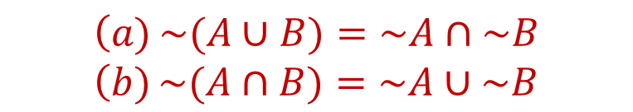
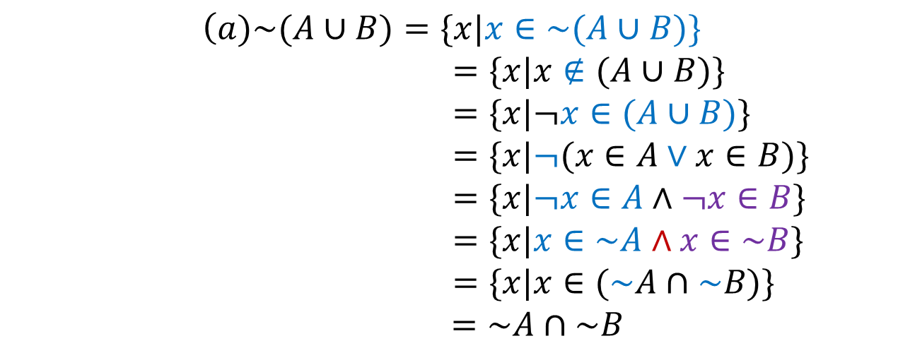
3.Difference(set complement)
集合运算
交 并
差（补）
对称差分
基本定律
包含排斥原理
Theorem 3.2-4: For ∀ sets A, B, then the following relations are true:
Proof:

Slide 9
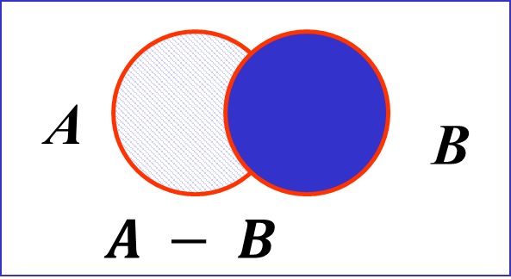
3.Difference(set complement)
集合运算
交 并
差（补）
对称差分
基本定律
包含排斥原理
Theorem 3.2-5: For ∀ sets A, B, then the following relations are true:
Proof: (b) assume , then and . as , then , so , that is
Assume , then and .
That is , and or .
Obviously, only and can be true.
That is .
2023/5/14
9/49

Slide 10
3.Difference(set complement)
集合运算
交 并
差（补）
对称差分
基本定律
包含排斥原理
Theorem 3.2-6: For ∀ sets A, B,C, then the following relations are true:
证：
Proof:
Also
因此，
From above

Slide 11
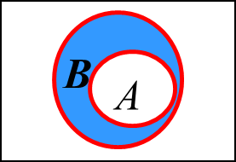
3.Difference(set complement)
集合运算
交 并
差（补）
对称差分
基本定律
包含排斥原理
Theorem 3.2-7: For ∀ sets A, B, if A ⊆ B, then:
~B ⊆ ~A
(B-A)∪A=B
Proof: (a) if x ∈A, then x ∈B. So if x ∉B, then there is x∉A.
That is, if x ∈~B, then x ∈~A . ~B ⊆ ~A.
As , then . That is (B-A)∪A=B

Slide 12
4.Symmetric Difference(对称差分)
集合运算
交 并
差（补）
对称差分
基本定律
包含排斥原理
Definition: For ∀ sets A and B, the union set of all the elements that belong to A but do not belong to B and all the elements that belong to B but do not belong to A, is called the symmetric difference set of A and B, written as .
Example: A={1,2,3}
B={3,2,4}
Then ={1,4}
E
A
B

Slide 13
4.Symmetric Difference
集合运算
交 并
差（补）
对称差分
基本定律
包含排斥原理
Symmetric difference set has the following properties:
E
A
B

Slide 14
4.Symmetric Difference
集合运算
交 并
差（补）
对称差分
基本定律
包含排斥原理
Prove:(A⊕B)⊕C= A⊕(B⊕C)
Proof:
As

Slide 15
4.Symmetric Difference
集合运算
交 并
差（补）
对称差分
基本定律
包含排斥原理
So,
Also,
Then,

Slide 16
4.Symmetric Difference
集合运算
交 并
差（补）
对称差分
基本定律
包含排斥原理
The above results can be clearly seen by the following Venn diagram:
E
E
E
C
C
C
A
B
A
A
B
B
A⊕B
(A⊕B)⊕C
= A⊕(B⊕C)
B⊕C

Slide 17
Chapter 3 Set Theory
3.3 Set Identities

Slide 18
Set Identities
集合运算
交 并
差（补）
对称差分
基本定律
包含排斥原理
Commutativity
Associativity

Slide 19
Set Identities
集合运算
交 并
差（补）
对称差分
基本定律
包含排斥原理
Distribution law
Double negation
De Morgan law
Equal power law
Remnant law
Identity law

Slide 20
Set Identities
集合运算
交 并
差（补）
对称差分
基本定律
包含排斥原理
Zeros law
Absorption law

Slide 21
Set Identities
集合运算
交 并
差（补）
对称差分
基本定律
包含排斥原理
Proof: (39) is transformed into, assume is false, prove is false. （后件为假，前件必为假）
is false, we have and are both false, that is and is true, which means is true. So is false.

Slide 22
Chapter 3 Set Theory
3.4 Principle of inclusion–exclusion

Slide 23
Principle of inclusion-exclusion
集合运算
交 并
差（补）
对称差分
基本定律
包含排斥原理
The operation of sets can be used for enumeration problem of finite elements.
Cardinality of a set A is the number of distinct elements in A, written as #A or |A|.
A₁, A₂ are finite sets, |A₁|, |A₂| are their cardinality, then we have:

Slide 24
Principle of inclusion-exclusion
集合运算
交 并
差（补）
对称差分
基本定律
包含排斥原理
Theorem 3.2-7: A₁, A₂ are finite sets, |A₁|, |A₂| are their cardinality, then:
Proof: (1) if A₁ and A₂ don’t intersect, that is A₁ ∩ A₂ =∅，
(2) if A₁ ∩ A₂ ≠∅，then

Slide 25
Principle of inclusion-exclusion
集合运算
交 并
差（补）
对称差分
基本定律
包含排斥原理
Example 3.4.1: There are 10 young people. 5 of them are workers,7 are students and 3 are both workers and students. How many young people are neither workers nor students?
Solution : suppose the set of workers is W and the set of students is S, then：
Also
So there is one young person who is neither a worker nor a student.

Slide 26
Principle of inclusion-exclusion
集合运算
交 并
差（补）
对称差分
基本定律
包含排斥原理
Principle generalization on three finite sets:
A₁
A₃
A₂

Slide 27
Principle of inclusion-exclusion
集合运算
交 并
差（补）
对称差分
基本定律
包含排斥原理
Solution: Assume
Let |P| be the number of elements in the finite set P, and
(floor function) be largest integer that is less than or equal to x,
be least common multiple of
Then,
Example 3.4.2: Find how many numbers between 1 and 1000 (including 1 and 1000) that can‘t be divided by 5 and 6 and 8.
can be divided by 5}
can be divided by 6}
can be divided by 8}

Slide 28
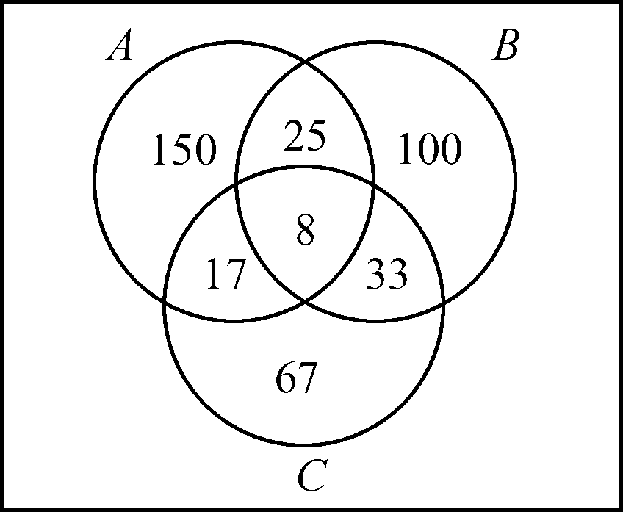
Principle of inclusion-exclusion
集合运算
交 并
差（补）
对称差分
基本定律
包含排斥原理
Then, we can assign the numbers to the Venn diagram, thus:

Slide 29
Principle of inclusion-exclusion
集合运算
交 并
差（补）
对称差分
基本定律
包含排斥原理
Example 3.4.3: A factory was to assemble 30 cars, and the equipment available was radio, air conditioner and intercom. Fifteen of the cars are known to have radio, eight have air conditioner, six have intercom, and three cars have all three. How many cars that do not have any equipment?
Answer: let A₁, A₂ and A₃ be car set with radio, air conditioner, and intercom, then
because
We have

Slide 30
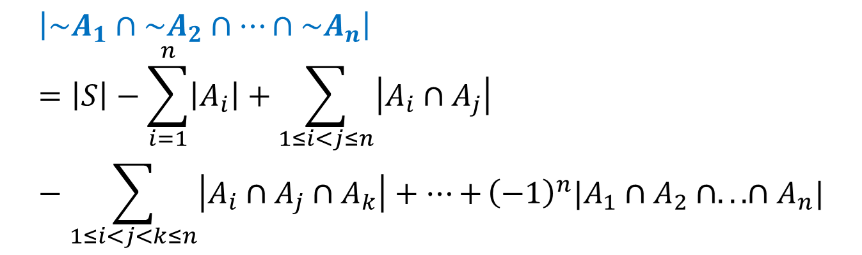
Principle of inclusion-exclusion
集合运算
交 并
差（补）
对称差分
基本定律
包含排斥原理
Principle generalization to n finite sets:
Theorem 3.4-2: A₁,A₂,…,A_{n} are n finite sets, which are the sets that have the properties P₁,P₂,…, P_{n} in the finite set S. Their cardinalities are|A₁|,|A₂|,…,|A_{n}|, then we have the size of the set that doesn’t have the properties P₁,P₂,…, P_{n} :

Slide 31

Principle of inclusion-exclusion
集合运算
交 并
差（补）
对称差分
基本定律
包含排斥原理
Proof: assume S is the universe set, from De Morgan’s laws,
So,
Then the original principle can be changed to prove:

Slide 32
Principle of inclusion-exclusion
集合运算
交 并
差（补）
对称差分
基本定律
包含排斥原理
The above formula can be proved by mathematical induction（数学归纳法）.
When n=2, prove
If , we have ,
Then is true.
If , we have
Then ,

Slide 33
Principle of inclusion-exclusion
集合运算
交 并
差（补）
对称差分
基本定律
包含排斥原理
So, for n=2, is true.

Slide 34
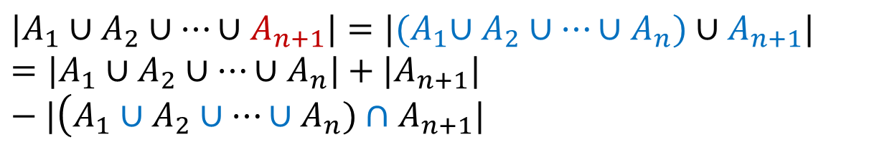
Principle of inclusion-exclusion
集合运算
交 并
差（补）
对称差分
基本定律
包含排斥原理
Assume
is true, then,

Slide 35
Principle of inclusion-exclusion
集合运算
交 并
差（补）
对称差分
基本定律
包含排斥原理

Slide 36
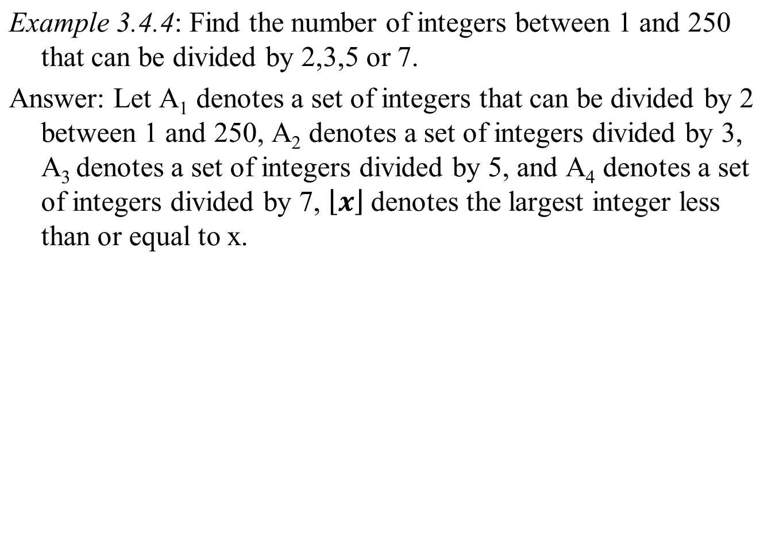
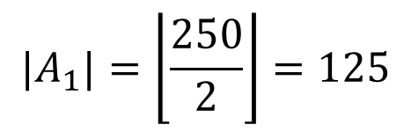
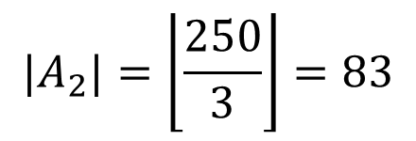
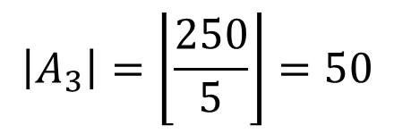
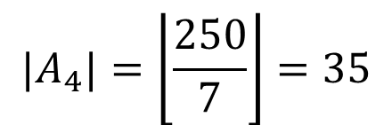
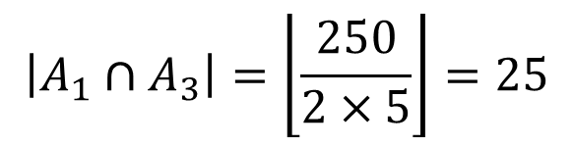
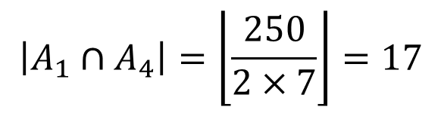
Principle of inclusion-exclusion
集合运算
交 并
差（补）
对称差分
基本定律
包含排斥原理

Slide 37
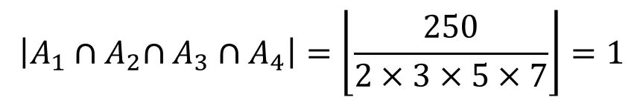
Principle of inclusion-exclusion
集合运算
交 并
差（补）
对称差分
基本定律
包含排斥原理
Then we have

Slide 38
Principle of inclusion-exclusion
集合运算
交 并
差（补）
对称差分
基本定律
包含排斥原理
Example 3.4.5: There are 100 students in a department who must learn at least one of the three languages of French, German and English. 42 of the 100 students study French, 45 learn German, 65 learn English, 15 learn French and German, 20 learn French and English, and 25 learn German and English.
Q. How many students are that learn three languages at the same time? How many students are that only learn English?

Slide 39
Principle of inclusion-exclusion
集合运算
交 并
差（补）
对称差分
基本定律
包含排斥原理
Solution: let A,B,C be French, German and English students.
Then
|A|=42,|B|=45,|C|=65,|A∩B|=15,|A∩C|=20,|B∩C|=25, |A∪B∪C|=100。
By the inclusion and exclusion principle:
|A∪B∪C| =(|A|+|B|+|C|)-(|A∩B|+|A∩C|+|B∩C|)+ |A∩B∩C|
So |A∩B∩C|=|A∪B∪C|-(|A|+|B|+|C|)+(|A∩B| +|A∩C|+|B∩C|)=8
The number of student who only learn English:
|C|-|A∩C|-|B∩C|+|A∩B∩C|=28

Slide 40
Principle of inclusion-exclusion
集合运算
交 并
差（补）
对称差分
基本定律
包含排斥原理
Example 3.4.6: Evaluate the Euler function. Euler function
is the number of prime numbers that are mutually prime with n in
For example, , because prime numbers that are mutually prime with 12 are 1,5,7,11.
Try to give the formula of Euler function by the inclusion and exclusion principle
Answer: Given positive integer n, is prime factorization of n, assume
Then
can divide x }

Slide 41
Principle of inclusion-exclusion
集合运算
交 并
差（补）
对称差分
基本定律
包含排斥原理
Let’s calculate the terms on the right-hand side,
According to the inclusion and exclusion principle
。
For example:

Slide 42
Homework
P,63：
10,11，14（2），15，16(1,3),17(2,4),18(1,3,5,7,9),19,20(2,4,6,8,10),21-24

Slide 43

The End
Thanks

